Slide 1

TreeMoney
First review presentation
A project by: Attilio Vanacore, Mouli Fernando, Nicola Mastrorilli,
Oriana Deliallisi, Simone Russolillo and Siria Sannino
Tutti i diritti relativi al presente materiale didattico ed al suo contenuto sono riservati a Sapienza e ai suoi autori (o docenti che lo hanno prodotto). È consentito l'uso personale dello stesso da parte dello studente a fini di studio. Ne è vietata nel modo più assoluto la diffusione, duplicazione, cessione, trasmissione, distribuzione a terzi o al pubblico pena le sanzioni applicabili per legge

Slide 2
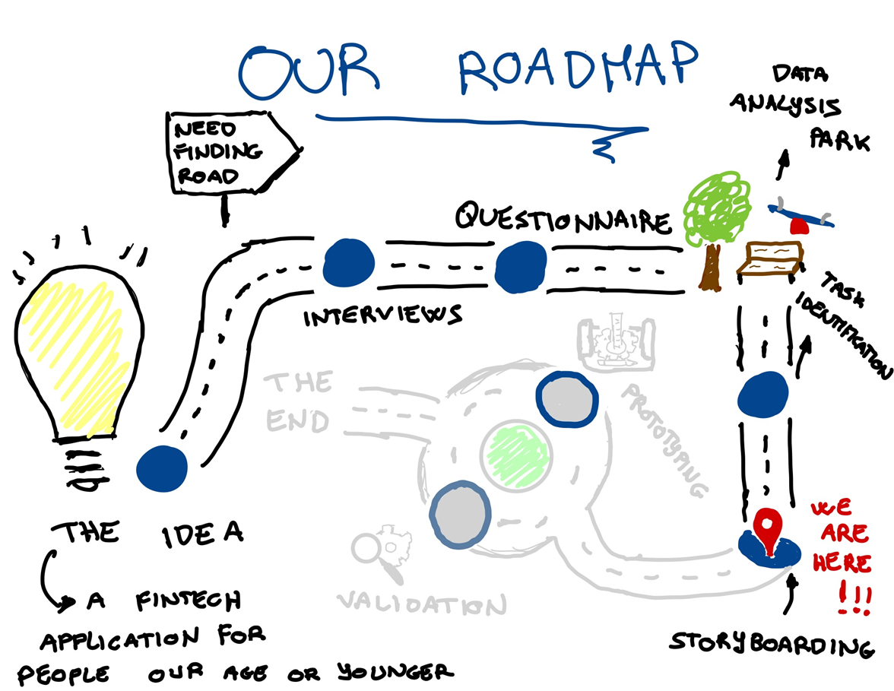

24/05/24
TreeMoney
Pagina 1
Notes:
siria

Slide 3
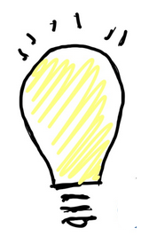


The idea
In the beginning, we tried to come up with a lot of ideas, but then we realized we didn’t need one, also not to fall in love with it.
So, we decided to concentrate the need finding on a target: Gen Z and their parents.
Our ideas would then come from the found needs
As we’ll see in a while: through the stages of need finding we actually decided to change our target only to Gen Z.
24/05/24
TreeMoney
Pagina 2
Notes:
siria

Slide 4
Need Finding: Interviews
We conducted the interviews in 2 phases, refining the questions between them
Phase 1
Phase 2
Who was interviewed:
We interviewed both parents and Gen Z,
differentiating the questions between the two.
How were the interviews conducted:
We conducted the interviews in person and stored the answers in a Google Form, so to have them all in one place.
In this phase, the questions were a lot and really broad: we tried to understand how people our age or younger managed money and how the parents handled the money outlet to their children
Who was interviewed:
We decided to shift our focus on the Gen Z and their needs only. Also, in this phase we used Chat GPT to create and interview personas
How were the interviews conducted:
We conducted the interviews in person, taking notes and trying not to be too schematic about it.
In this phase we kind of had the needs identified already, so we decided to refine the questions to confirm what we found.
Also, the questions used in this phase were the base for the questionnaire
24/05/24
TreeMoney
Pagina 3
Notes:
simone

Slide 5

Need finding: interviews
Interviewing with Chat GPT
After a series of prompts asking Chat GPT to create personas to interview, these are the ones we did the interviews with
Alex
The aspiring entrepreneur
Sarah
The college student
Sarah, the College Student
The answers we got back were actually in line with those we got from real people, however, the personas were localized in the USA so in some cases they used examples that could only be applied to that context(e.g, used applications)
Questions presented to Chat Gpt in a flowchart-like way
Priya
The balanced planner
Mark
The recent graduate
Jake
The carefree spender
Emily
The anxious saver
24/05/24
TreeMoney
Pagina 4
Notes:
nicola

Slide 6
Found Needs
Thanks to the interviews, we manage to identify the following needs
A way to counter the fact that NFC payments make spending less noticeable
 | Handling money related anxiety for Gen Z
Visual and clear ways to visualize income and expenses
 | A way to divide budget and set priorities
An application that let you handle all your money
 | An easy and intuitive way to transfer money
24/05/24
TreeMoney
Pagina 5
Notes:
siria

Slide 7
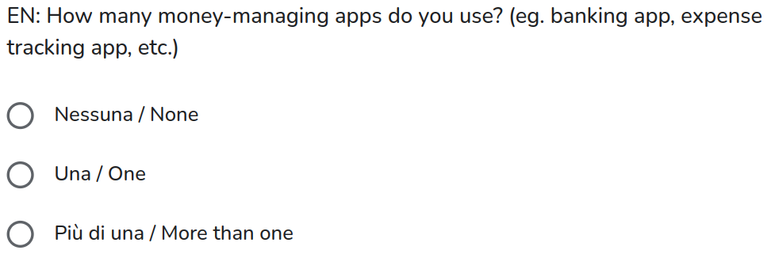
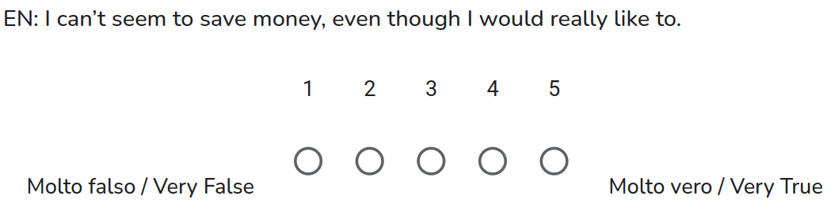
Need Finding: Questionnaire
The questionnaire was made to make sure that those were actually needs for more than 30 people and to find new ones.
We had almost 120 answer, plus 18 from Chat GPT personas.
We tried to make it as neutral and free of our ideas as possible with questions in the form of radio buttons.
Here’s some examples.
24/05/24
TreeMoney
Pagina 6
Notes:
simone

Slide 8
Need finding: questionnaire
Questionnaire with Chat GPT
To have more personas to answer the questionnaire we asked Chat GPT to create 3 different instances of each persona we used for the interviews, thus resulting in 18.
Priya
The balanced planner
Alex
The aspiring entrepreneur
Sarah
The college student
Mark
The recent graduate
Emily
The anxious saver
Jake
The carefree spender
Each instance of a persona is a shade of it and each answered to the questionnaire in different ways, all slightly different from one another.
24/05/24
TreeMoney
Pagina 7
Notes:
nicola

Slide 9
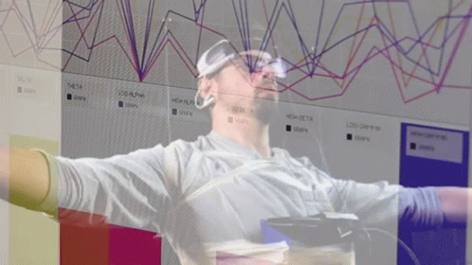
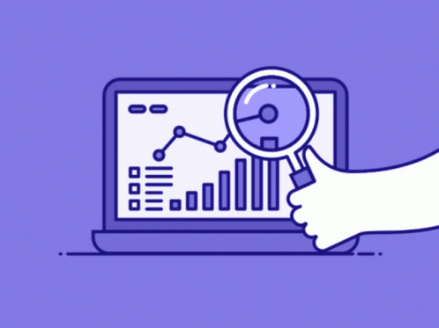


Data Analysis
24/05/24
TreeMoney
Pagina 8
Notes:
attilio

Slide 10
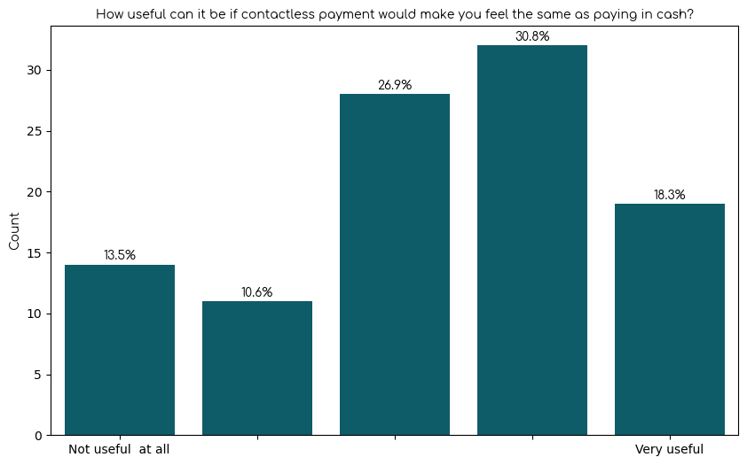
Data Analysis
How useful can it be if contactless payment would make you feel the same as paying in cash?
A way to counter the fact that NFC payments make spending less noticeable
Almost 70% of people would find it somewhat useful to receive a better feedback when paying with their phone
24/05/24
TreeMoney
Pagina 9
Notes:
attilio

Slide 11
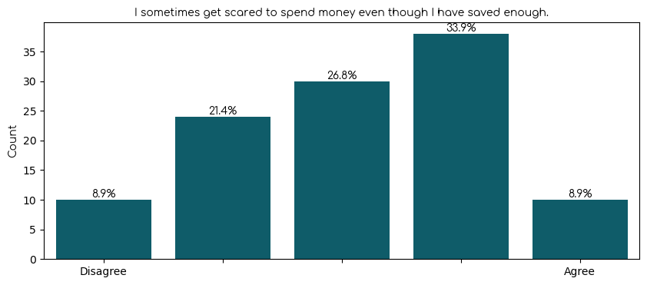
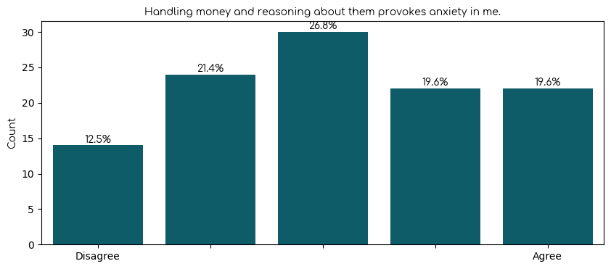
Data Analysis
Handling money related anxiety for Gen Z
Distribution of answers in the “Money and Feelings” section is more or less inconclusive as we couldn't identify a proper need.
I sometimes get scared to spend money even though I have saved enough
Handling money and reasoning about them provokes anxiety in me
24/05/24
TreeMoney
Pagina 10
Notes:
attilio

Slide 12
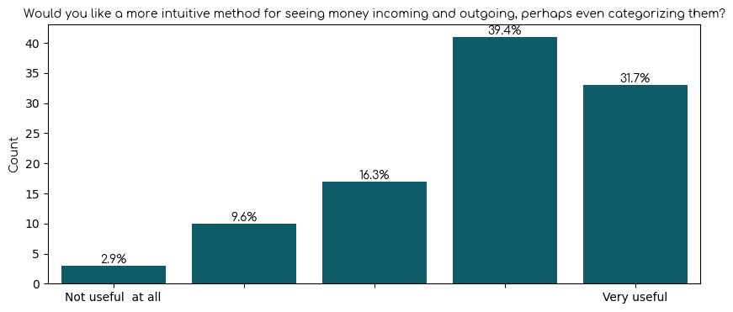
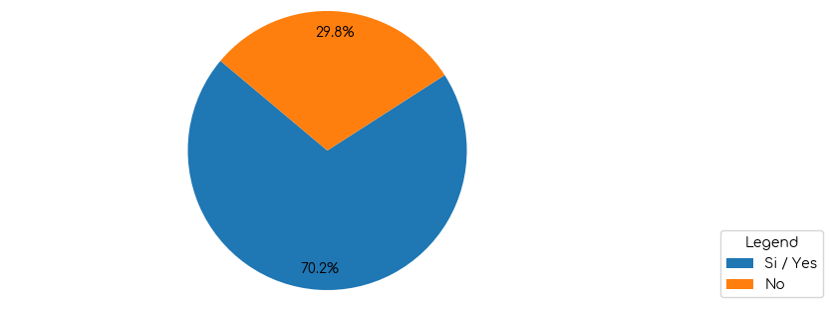
Data Analysis
Visual and clear ways to visualize income and expenses
4. Budget division and prioritization
We found out that people indeed do struggle to divide their budget and categorize their expenses
Would you like a more intuitive method for seeing money incoming and outgoing, perhaps even categorizing them?
Have you ever felt the need to divide your budget into categories for different purposes?
24/05/24
TreeMoney
Pagina 11
Notes:
attilio

Slide 13
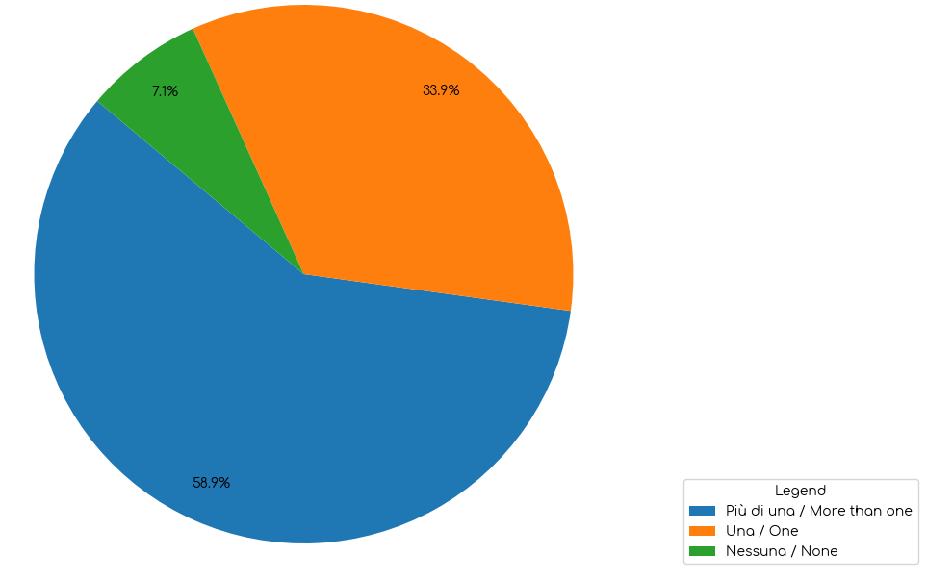
Data Analysis
How many money-managing apps do you use?
An application that let you manage all your money
A good portion of people need to use more than one app for different tasks highlighting the need for an app that incorporates different functions.
24/05/24
Wally
TreeMoney
Pagina 12
Notes:
attilio

Slide 14
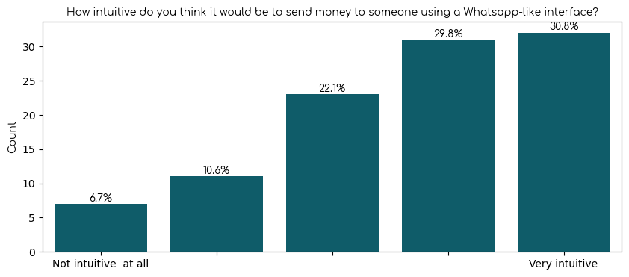
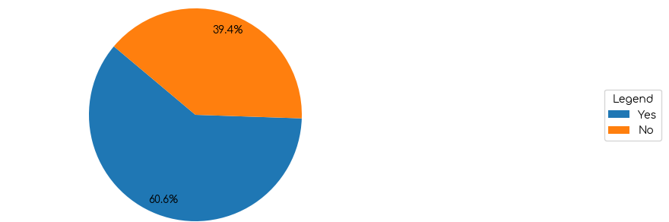
Data Analysis
An easy and intuitive way to transfer money transfer
Majority of people would appreciate a more faster and more intuitive way to send money.
Would you like a simpler and faster way to send money to someone?
How intuitive do you think it would be to send money to someone using a Whatsapp-like interface?
24/05/24
Wally
TreeMoney
Pagina 13
Notes:
attilio

Slide 15
Task Identification
After analyzing needs, various ideas came to mind by analyzing “competitor apps”
Money spending alert and reminders
AI expense advisor
Projects (as seen in Hype)
Virtual adjustable wallet
Gamification approach
Budget division and categorization
AI Gift advisor
Recurring bank transfer for shared subscriptions (as seen on PayPal)
and so on…
24/05/24
Wally
TreeMoney
Pagina 14
Notes:
oriana
task: an action a user performs on a device to get something done
projects: it’s basically a wallet where its gonna save the remainder of payments you make
gamification approach: Whatsapp like interface
gift advisor: advising asking questions like budget, what type of gift they like and it suggests gift.

Slide 16
Task Identification
Out of those we selected just 4
Make the feel of paying contactless the same as paying in cash
 | Categorize incoming and outgoing transactions
WhatsApp-like interface for exchanging money
 | Financial advisor
24/05/24
Wally
TreeMoney
Pagina 15
Notes:
mouli
Why did we choose these 4, how do we plan on tackling them.

Slide 17


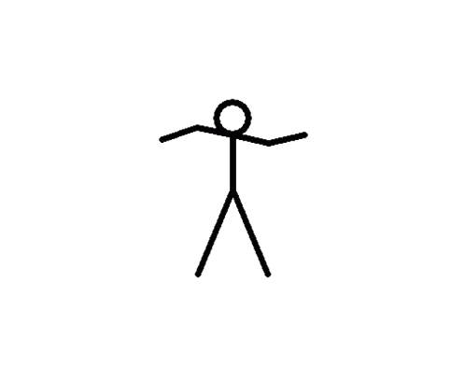

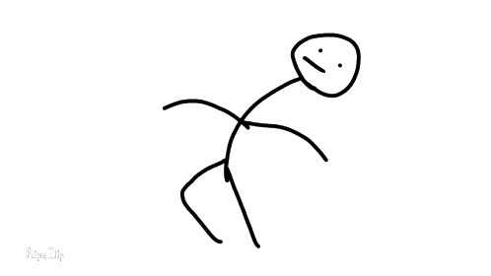



add border to selection of image in gimp
Storyboarding
24/05/24
Wally
TreeMoney
Pagina 16

Slide 18
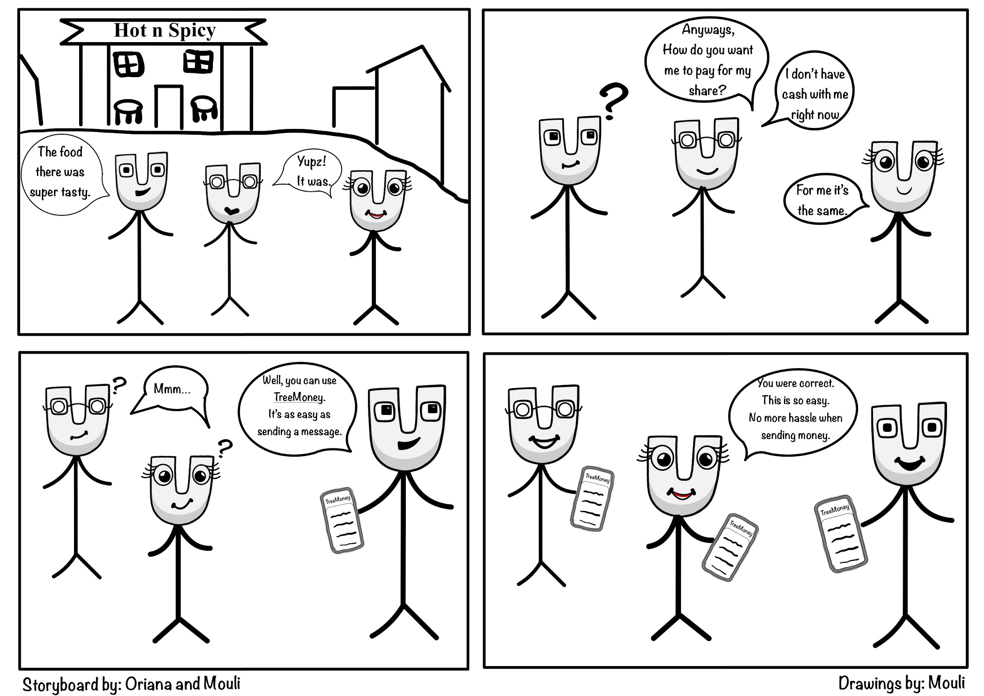
Storyboarding
Task 1
24/05/24
Wally
TreeMoney
Pagina 17
Notes:
mouli

Slide 19
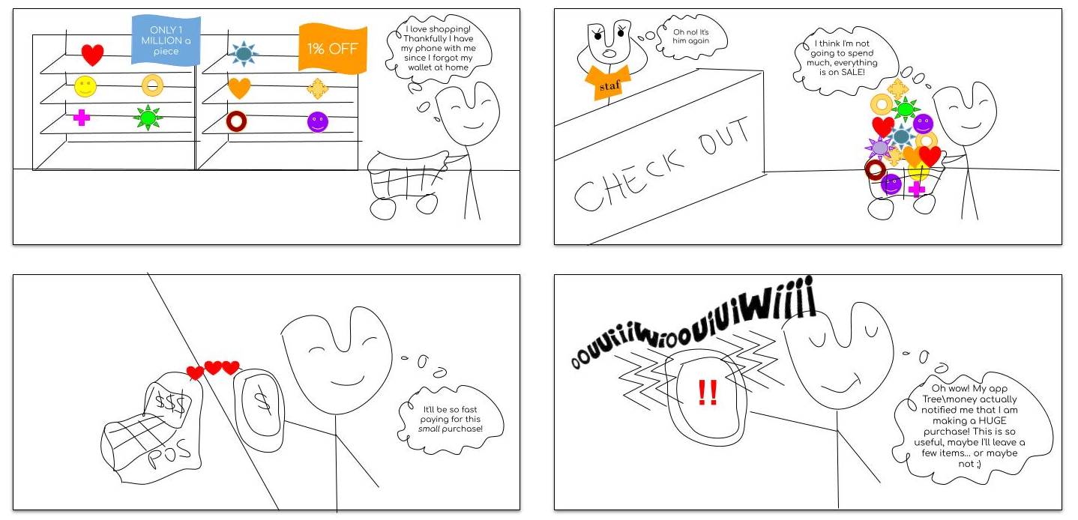
Storyboarding
Task 2
24/05/24
Wally
TreeMoney
Pagina 18
Notes:
oriana

Slide 20
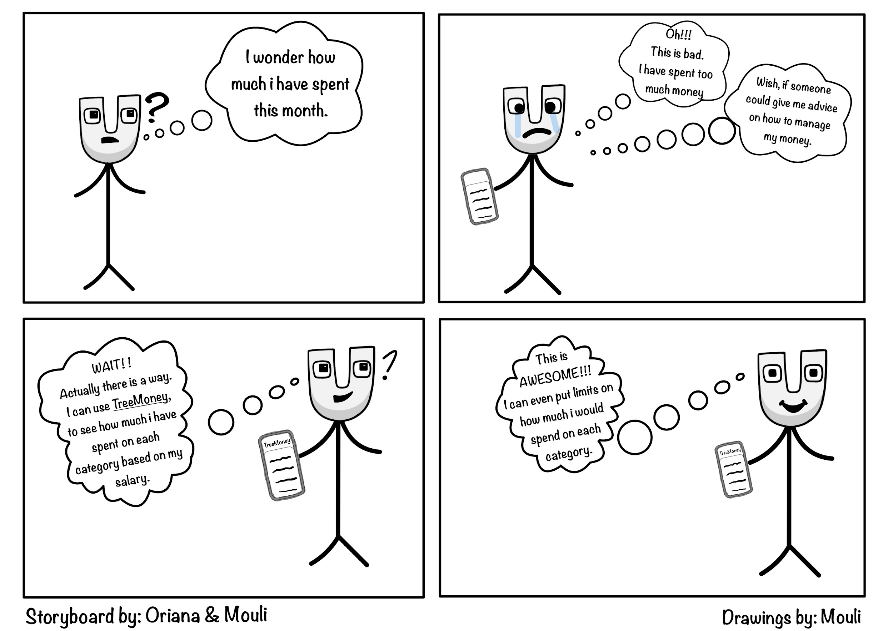
Storyboarding
Task 3
24/05/24
Wally
TreeMoney
Pagina 19
Notes:
mouli

Slide 21
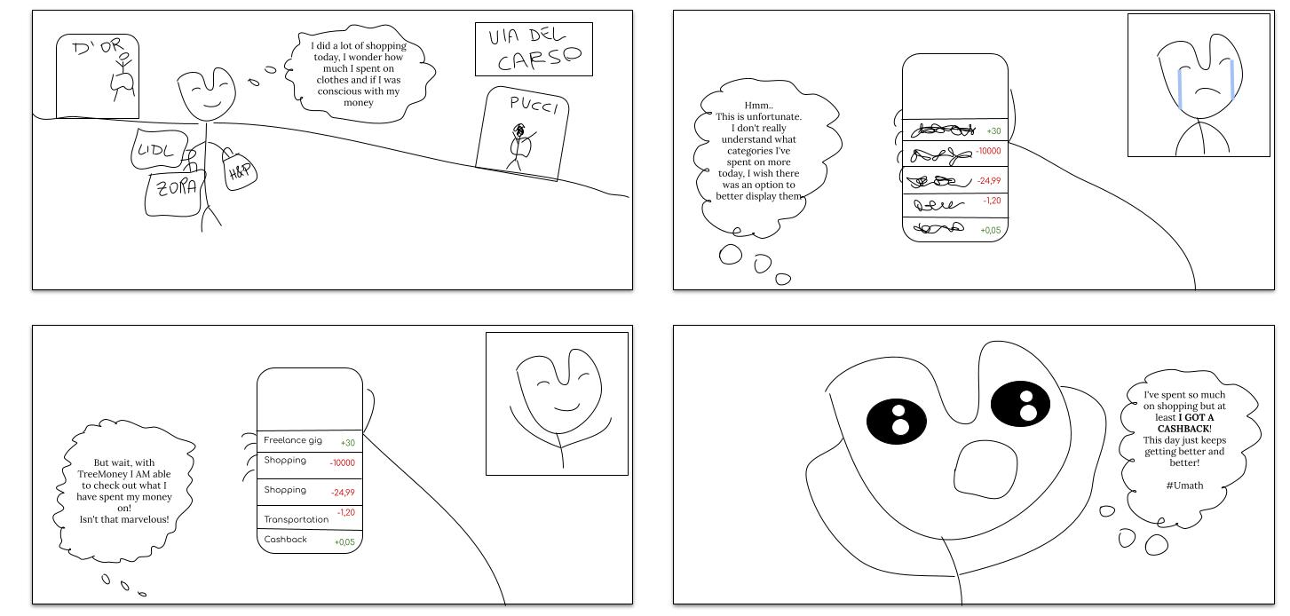
Storyboarding
Task 4
24/05/24
TreeMoney
Pagina 20
Notes:
oriana

